Slide 1
HOME AUTOMATION USING NODE MCU
Names :- Mandavalli Sumanth
Tangudu Sravani
Registration no :200101120054 ,
200101120010
Course : Smart Engineering Project
Subject code :CUTM1023
Guided by:-Proff Ashish Rangan Das

Slide 2
CONTENTS
Overview
Introduction
Components Required
Proposed Work
Block diagram of proposed model
Control Type
Methodology

Slide 3
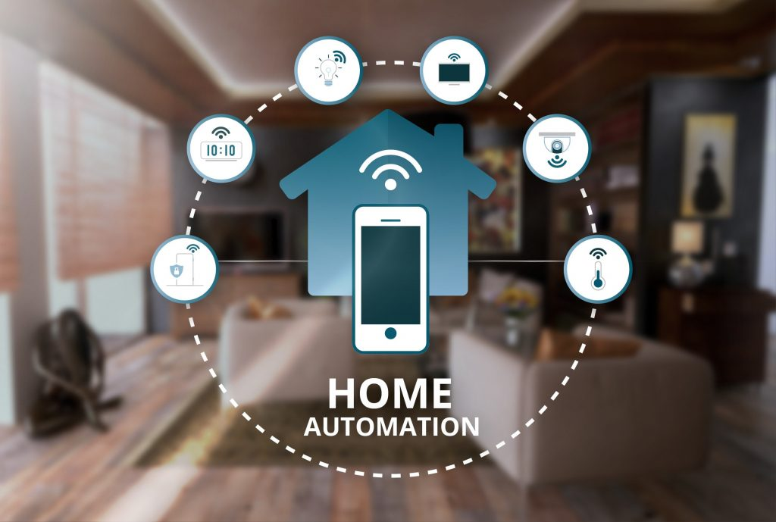
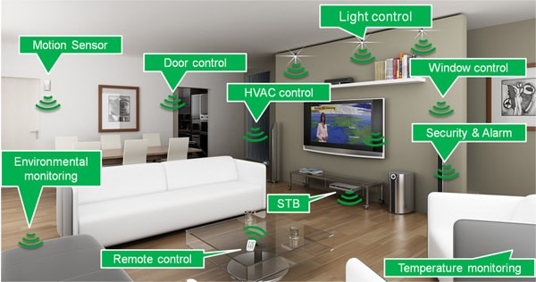
Overview

Slide 4
INTRODUCTION
A system is being designed which will control electrical appliances by smart phone with android app.
Components like node mcu use android application.
There are 1 wi-fi connections at NODE MCU end.
This device can also work from a long distance.

Slide 5
Components Required
NodeMCU
Bread Board
IR sensor
100 ohm Resistor
LED
Jumper Wires

Slide 6
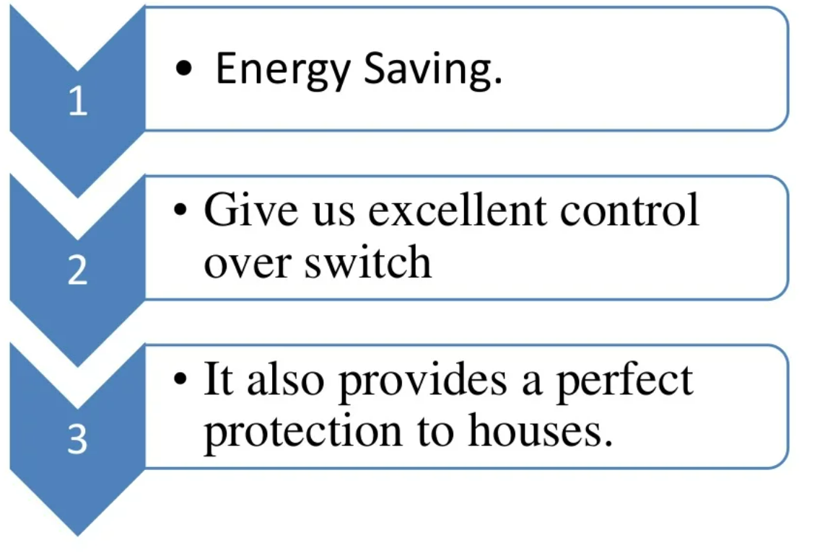
PROPOSED WORK

Slide 7
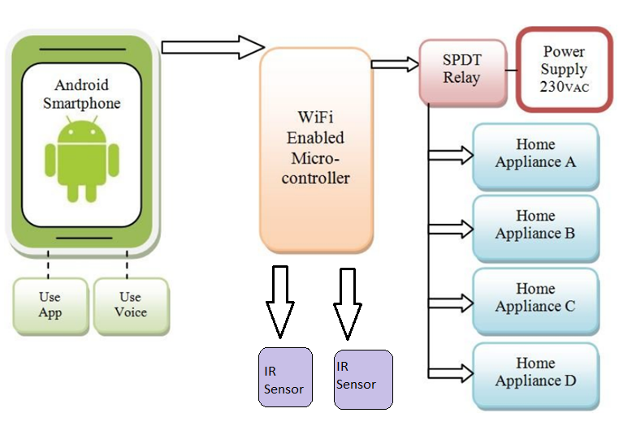
BLOCK DIAGRAM

Slide 8
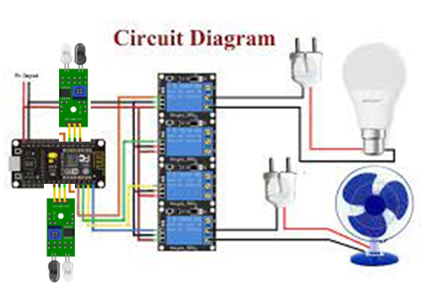
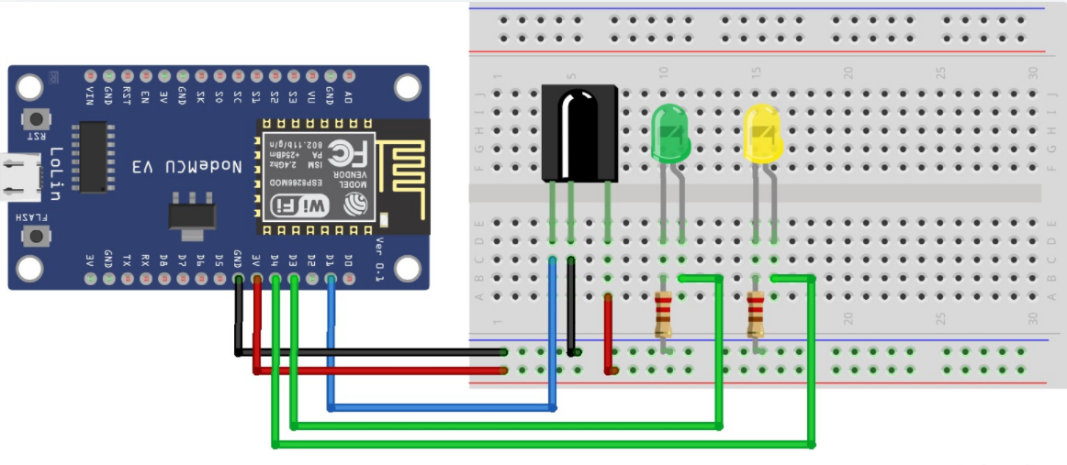
Circuit Diagram

Slide 9
CONTROL TYPE
1)MANUAL CONTROL.
1. Set The Function of Switches In Application of Blynk.
2.Checkout All The Connection First..
2)VOICE CONTROL
1. site IFTTT sign in Create the Google Assistant Applets (triggers for controlling).
2.Then after creating applets Configure those applets with WebHooks.
3.Connect Blynk the Web-Hooks by creating the Trigger weblink to Blynk App.
4. The link is available on net.. just copy the link and add AuthToken and set the pin
Number.
5. All set now just check the set-up with google assistant by giving commands
3)IR sensor
Automatic device automation occurs with help of sensing the motion of the person.

Slide 10
METHODOLOGY
Make Connection As Per Circuit Diagram
Download Blynk App and get Auth Token i.e Authorized Token ID.
Then Connect The NodeMCU pins Output To The Relay Driver Circuit
Then Start Programming the NodeMCU Module
which include the ipaddress and wifi password and Blynk Auth token .
Programme The NodeMCU Using Aurdino IDE Software.
Download the Blynk Library zip File, Install it from add library files.
Download the NodeMCU boards From preferences, by inserting the library linking it.
Compile the Programme check errors and Upload to NodeMCU .
Pairing occurs NodeMCU Module With Android Application . i.e. Blynk App.

Slide 11


